Slide 1


ハンフリー10-2とOCTから算出する網膜神経節細胞数
田邉 義政^{1）} 小川 俊平^{2,3）} 野呂 隆彦^{2）4)} 伊藤 義徳²⁾
奥出 祥代^{2）} 郡司 久人^{1）} 中野 匡^{2）}
1）東京慈恵会医科大学附属柏病院 眼科
2）東京慈恵会医科大学 眼科学講座
3)厚木市立病院 眼科
4)スタンフォード大学

Slide 2
背景
網膜神経節細胞(RGC)の50%が黄斑部に集中しており（ref; Quigry?）、黄斑の機能と構造の関係を分析することは視覚の理解、ひいては緑内障の早期発見、経過観察に重要である。

Slide 3
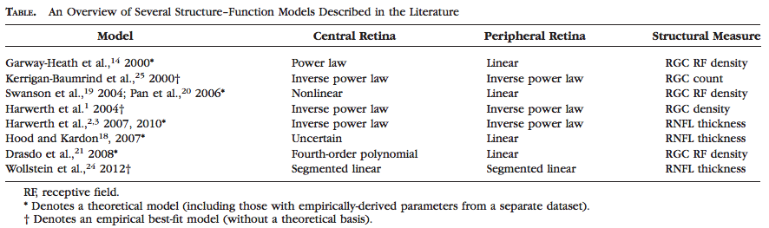
これまでのStructure-Function model

Slide 4
目的
今回我々は、HarwerthらのRGC数算出方法を応用し、ハンフリー視野10-2(HFA10-2)と光干渉断層計(OCT)からRGC数を算出し、検討したので報告する。

Slide 5
対象
2009年9月から2017年6月に慈恵医大附属病院眼科においてHFA10-2とOCTを同日に測定し、HFA10-2の信頼性指標と
OCT基準を満たす154症例、673データセット
HFAの信頼性(固視不良20%未満、偽陽性15%未満、偽陰性33%未満)
OCT（image quality 5/10 以上、複数回撮像のうち最良の画像を選択）
Notes:
2009年9月から2015年7月までに慈恵医大附属病院緑内障専門外来を受診した345例661眼のうちハンフリーの信頼性指標を満たす330例572眼です。開放隅角緑内障と正常眼圧緑内障を対象としました★

Slide 6
対象
平均±標準偏差 | POAG 258 | NTG 357 | PPG 14 | OHT 2 | Healthy 43 | All 673
平均年齢(歳) | 58.1±9.0 | 56.4±9.2 | 47.6±4.5 | 24.0±0.0 | 28.5±7.9 | 56.8±9.4
平均等価球面度数(D) | -5.62±4.1 | -4.94±3.3 | -5.40±0.3 | -7.19±0.3 | -3.15±2.3
性別(F:M) | 98:160 | 118:238 | 14:0 | 0:2 | 35:8 | 230:400
MD(dB) 10-2? | -13.4 ±11 | -7.30 ±8.1 | 0.25 ±0.8 | -3.20 ±0.8 | -0.49±0.8 | -9.6±9.7
Mean +/- SD
One-way ANOVA
Notes:
POAG,NTGの2群間で平均年齢とVFIに有意差は認められましたがそれ以外で有意差はありませんでした★

Slide 7
方法
測定機器
光干渉断層計
Cirrus HD-OCT（OCT:Carl Zeiss）
optic disc cube 200×200
静的視野計
Humphrey視野計(HFA:Carl Zeiss）
SITA Standard中心 10-2
同一日に測定、Medeirosらの方法を用いてRGC数を算出*
*Felipe A. Medeiros, et al, ArchOphthalmol. 2012
Notes:
実際の解析法ですが、ハンフリーシータスタンダード30－2とOCTのオプティックディスクキューブを同日に行い、患者の年齢、視神経乳頭の面積、平均網膜神経線維層厚、視野の実測値、MD値、年齢からＣＳＦＩを算出します★

Slide 8
Weighted RGC
網膜神経節細胞数(RGC)をSAPおよびOCTから推定
m=[0.054*(ec*1.32)]+0.9
b=[-1.5*(ec*1.32)]-14.8
gc={[(s-1)-b]/m}+4.7
SAPrgc=∑10^(gc*0.1)
d=(-0.007*age)+1.4
c=(-0.26*MD)+0.12
a= averageRNFLthickness*10870*d
OCTrgc=10^({(log(a)*10]-c}*0.1)
SAP
OCT
wrgc=(1+MD/30)*OCTrgc+(-MD/30)*SAPrgc
FelipeA. Medeiros, et al, ArchOphthalmol. 2012
Notes:
ここでCSFIの、算出法について、概略をご説明します。ＣＳＦＩは自動視野計と光干渉断層計の所見から、網膜神経節細胞数を推定し、正常眼に比べRGCがどの程度減少しているかを 表します。wrgcは初期はOCTから推定されるRGCに重きをおいて、後半は視野から推定されるRGCに重きをおいて計算されます★

Slide 9
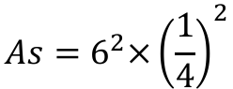
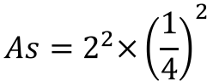
RGC_HFA
m=[0.054*(ec*1.32)]+0.9
b=[-1.5*(ec*1.32)]-14.8
gc={[(s-1)-b]/m}+4.7
RGC_HFA =[∑10^(gc*0.1)]/9
ganglion cell quantity (gc)
visual field sensitivity (s)
eccentricity (ec)
$$As=6^{2}×{\left(\frac{1}{4}\right)}^{2}$$
30-2 6°
36/4 =9
$$As=2^{2}×{\left(\frac{1}{4}\right)}^{2}$$
10-2 2°
Medeiros FA. ArchOphthalmol. 2012
Notes:
RGC_HFAは、

Slide 10
RGC_OCT
d = (−0.007*age) + 1.4
c = (−0.26*macular TD) + 0.12
a = ave cpRNFLT*θ/360*10870*d
RGC_OCT= 10^[(log(a)*10 −c)*0.1]
cpRNFL
360
180
Zhang C. Ophthalmology 2014

Slide 11
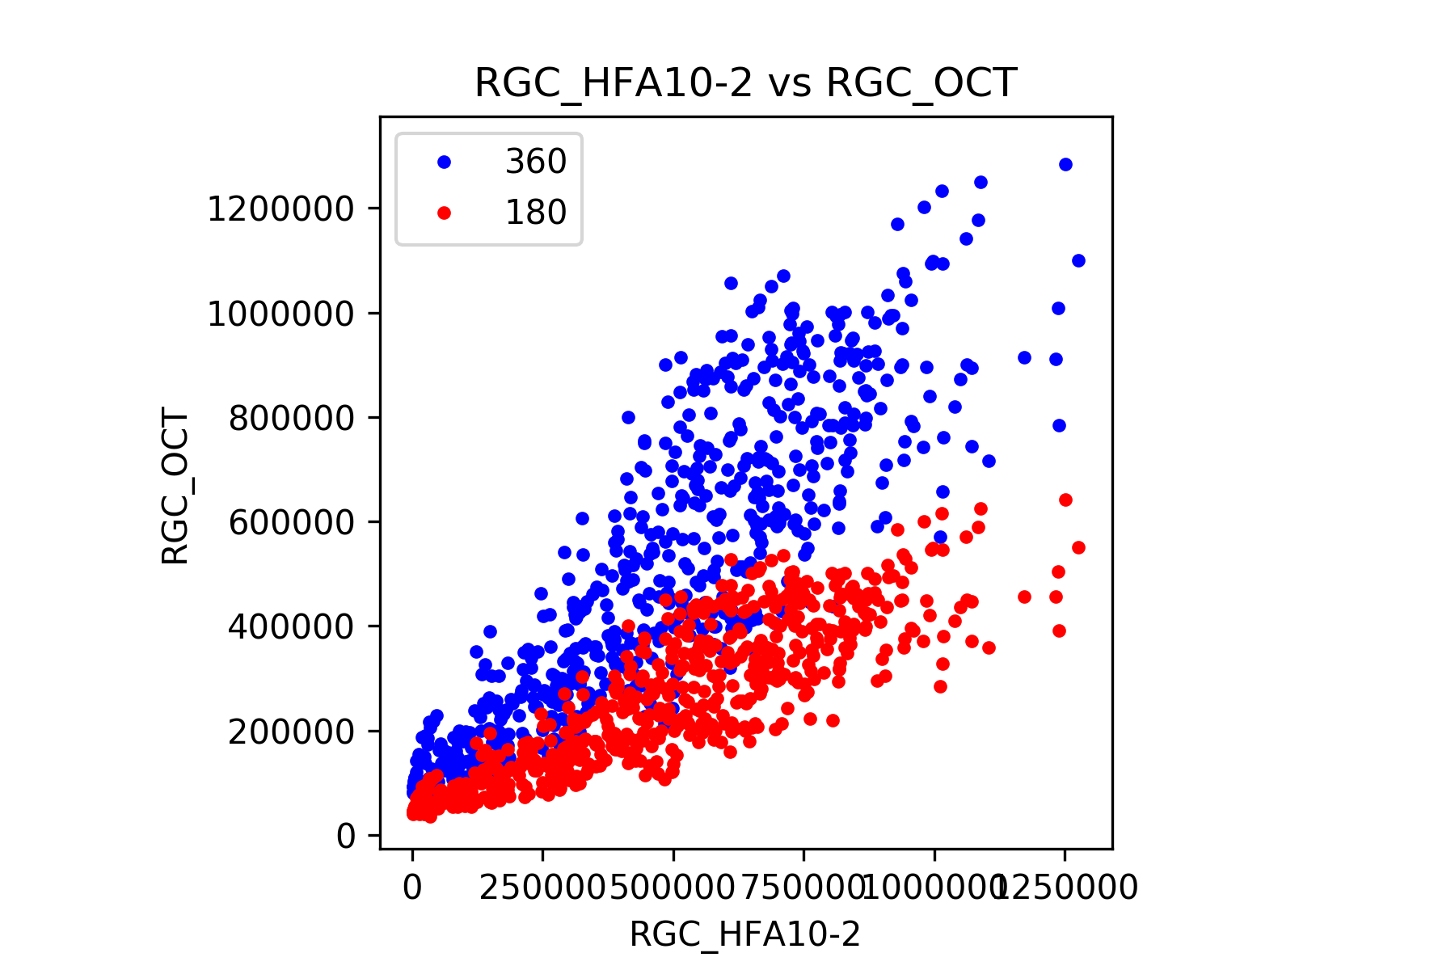
RGC from cpRNFLT 360 degree vs. 180 degree
cpRNFL
360
180
Zhang C. Ophthalmol 2014
360 degree was better model

Slide 12
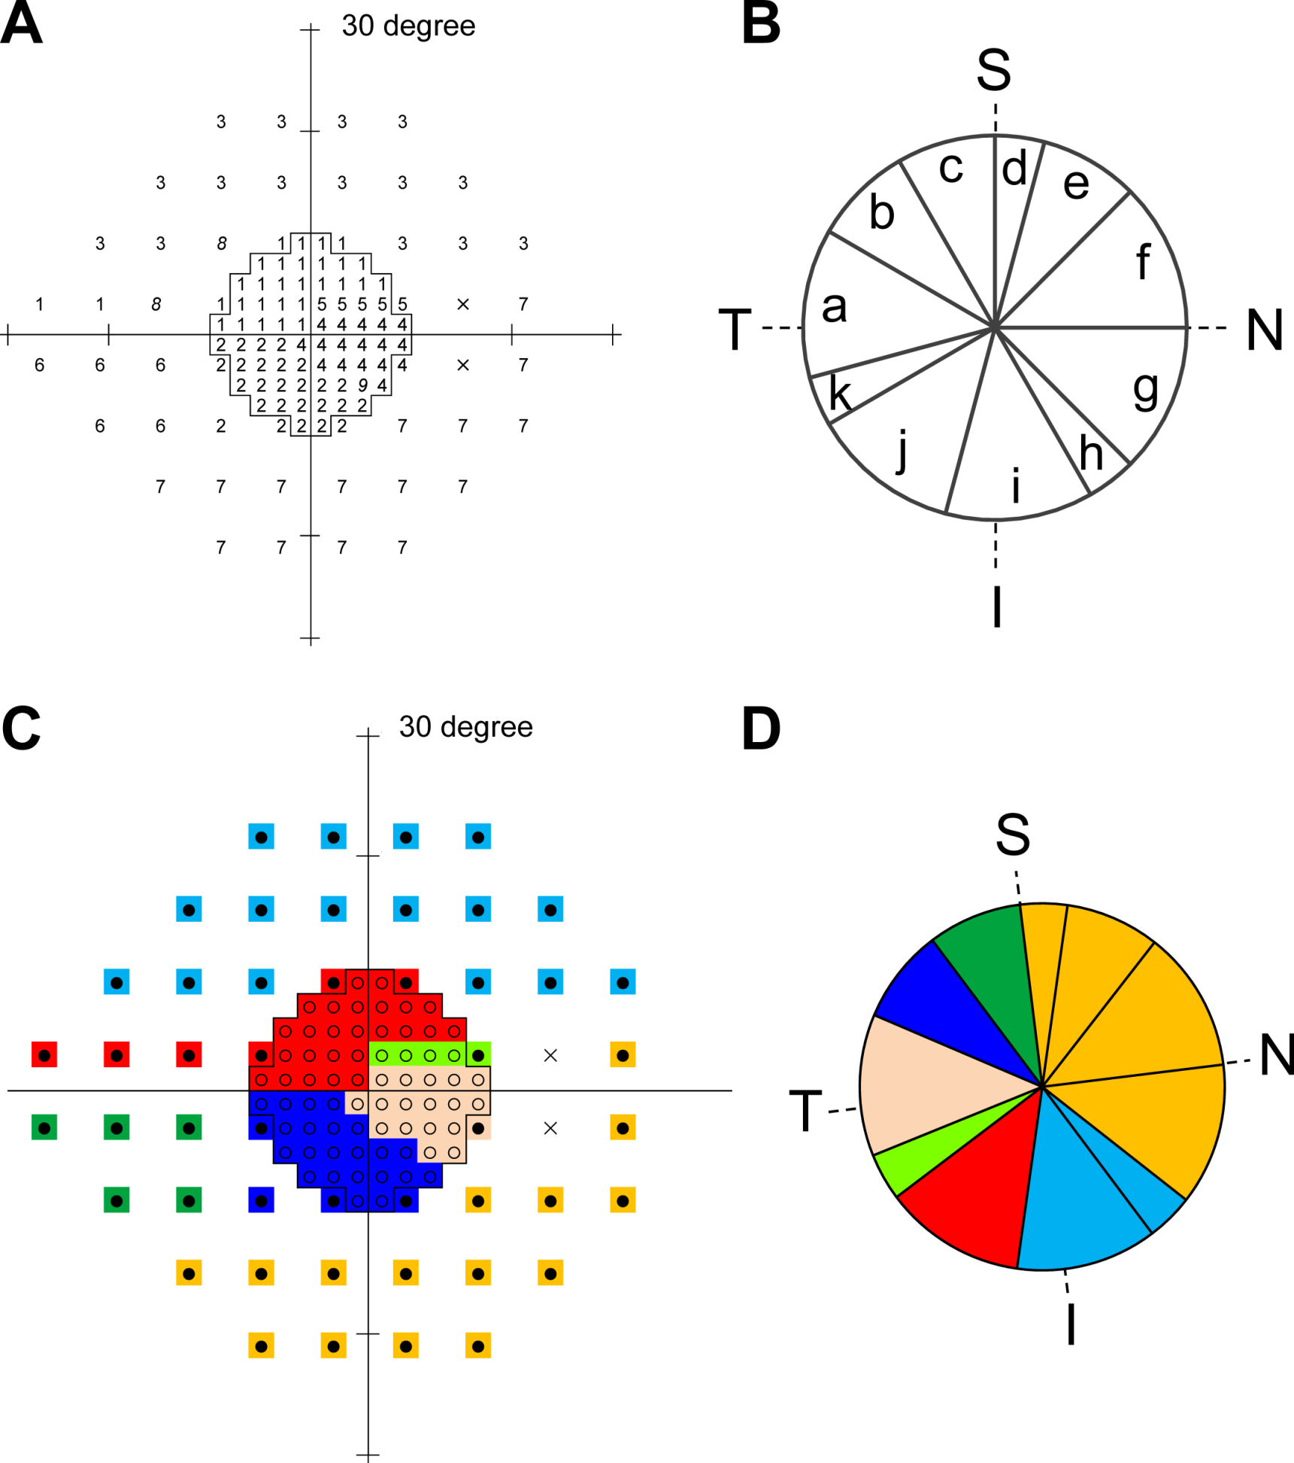
10-2測定点とcpRNFLTの対応
Center 8 degree
Center 10 degree
135 degree
Hood DC. Prog Retin Eye Res. 2013
Nakanishi H. IOVS. 2016
Notes:
Clustering maps of VF test points and cpRNFLT sectors using EFA. The pattern matrix of the EFA for the combined 116 VF test points is shown in Supplementary Table S1, and the pattern matrix of the EFA for the 24 cpRNFLT sectors is shown in Supplementary Table S2. (A) Mapping of the factor numbers with the largest factor loadings of the 116 test points of combined 24-2 and 10-2 VF tests. By grouping the 116 VF test points based on the common factors with the largest factor loading, the EFA suggested that the VF test points could be grouped into nine VF clusters. Among them, clusters based on factor 8 and factor 9 contained two discontinuous VF test points and only one VF test point, respectively (shown in italics). According to the second largest factor loading, each VF test point was grouped into the cluster based on factors 3, 1, and 4, respectively (Supplementary Table S1). Finally, the combined 116 VF test points were grouped into seven VF clusters. (B) The EFA suggested that the 24 cpRNFLT sectors could be grouped into 11 clusters based on the common factor with the largest factor loading. (C, D) Color-coded maps showing the correlations between the VF test clusters and the cpRNFLT clusters. The correlation matrix of the 7 VF clusters and 11 cpRNFLT clusters is shown in Table 2. The mean degree of fovea–ONH center axis was −6.98° ± 3.85°.

Slide 14
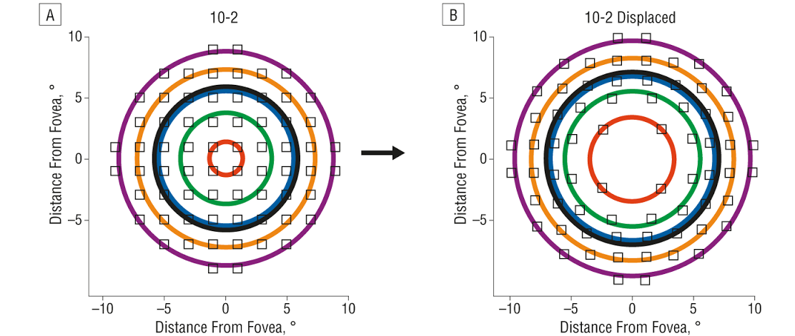
RGC displacement
1°, 3°, 5°, 7°, 9°
3.4°, 5.6°, 6.8°, 8.3°, 9.7°
Raza AS, et al. Arch Ophthalmol 2011

Slide 15
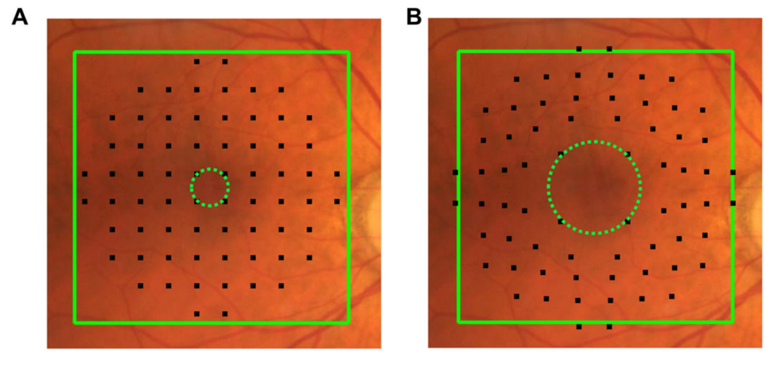
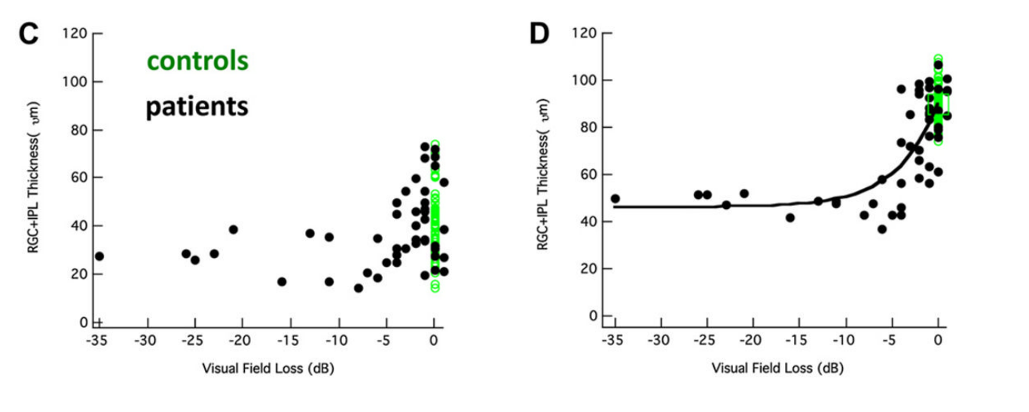
RGC displacement
Hood DC. Prog Retin Eye Res. 2013

Slide 16
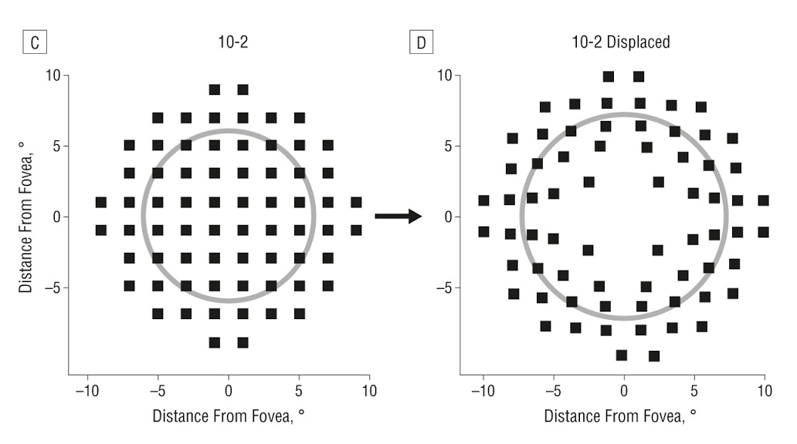
RGC displacement
1°, 3°, 5°, 7°, 9°
3.4°, 5.6°, 6.8°, 8.3°, 9.7°
Raza AS, et al. Arch Ophthalmol 2011

Slide 17
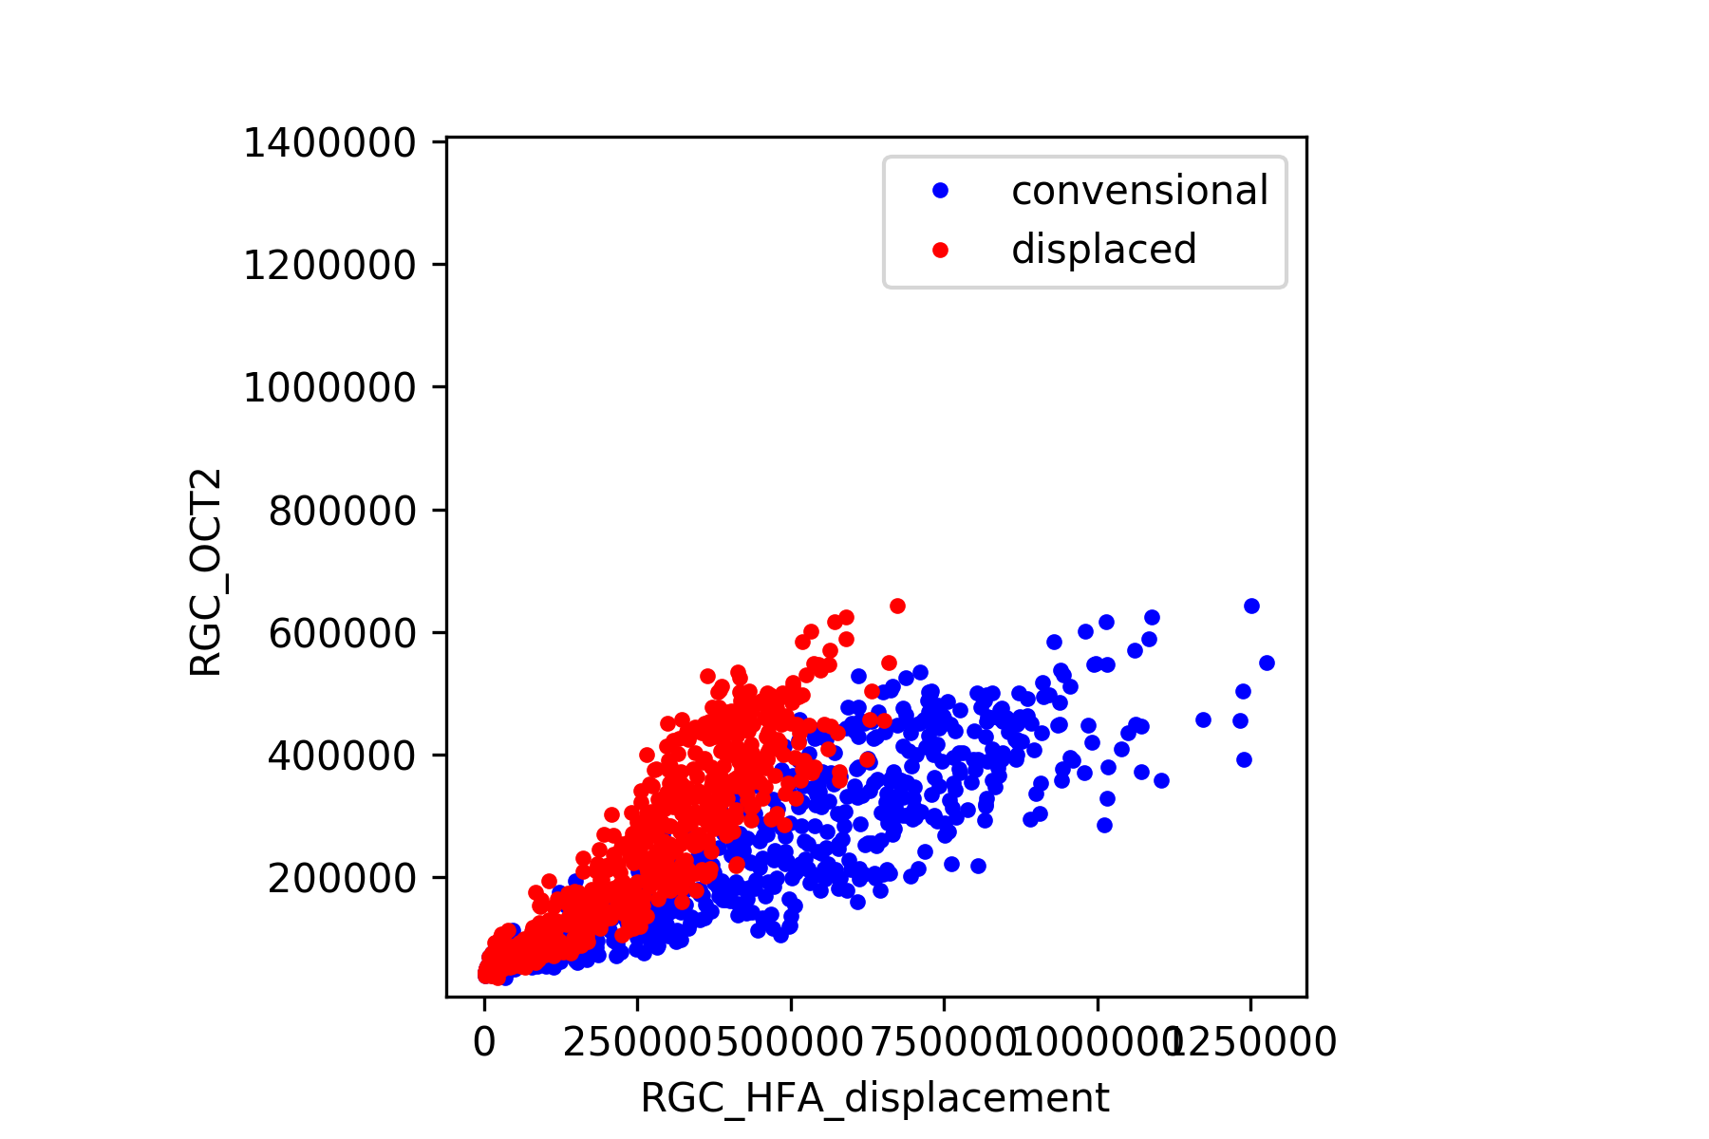
Displacedの方がOCT180°と一致
360°の関係も追加

Slide 18
Harwerth model
中心RGCは発散

Slide 19
Factor analysis

Slide 20
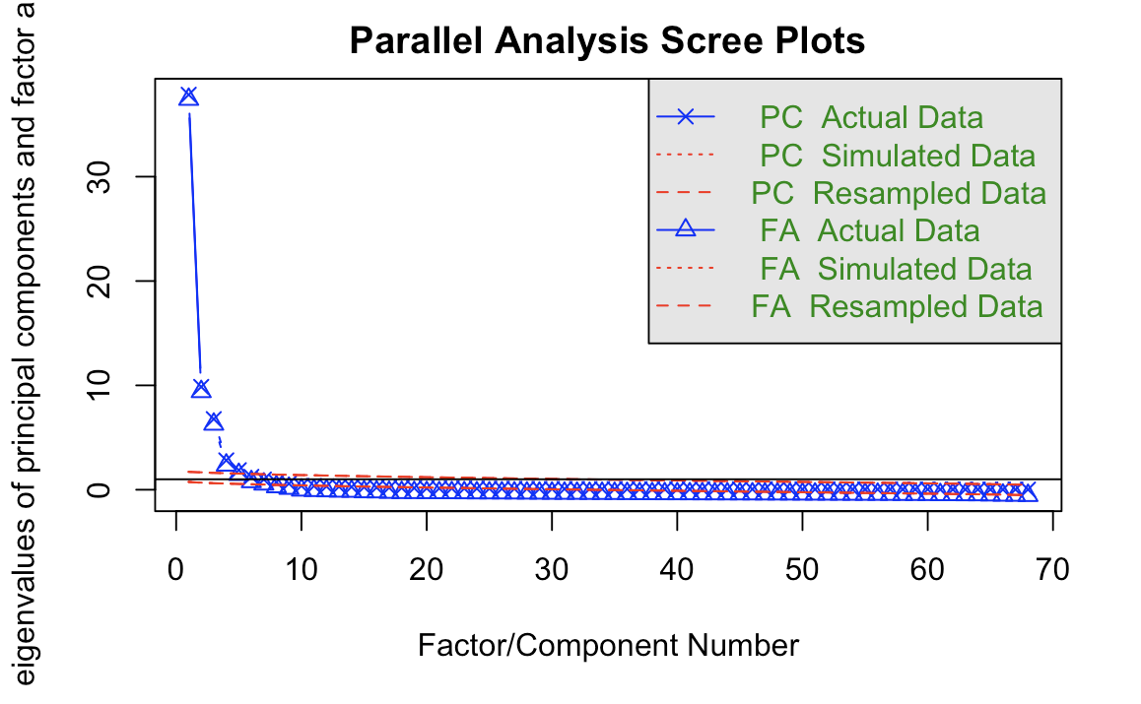

Slide 21
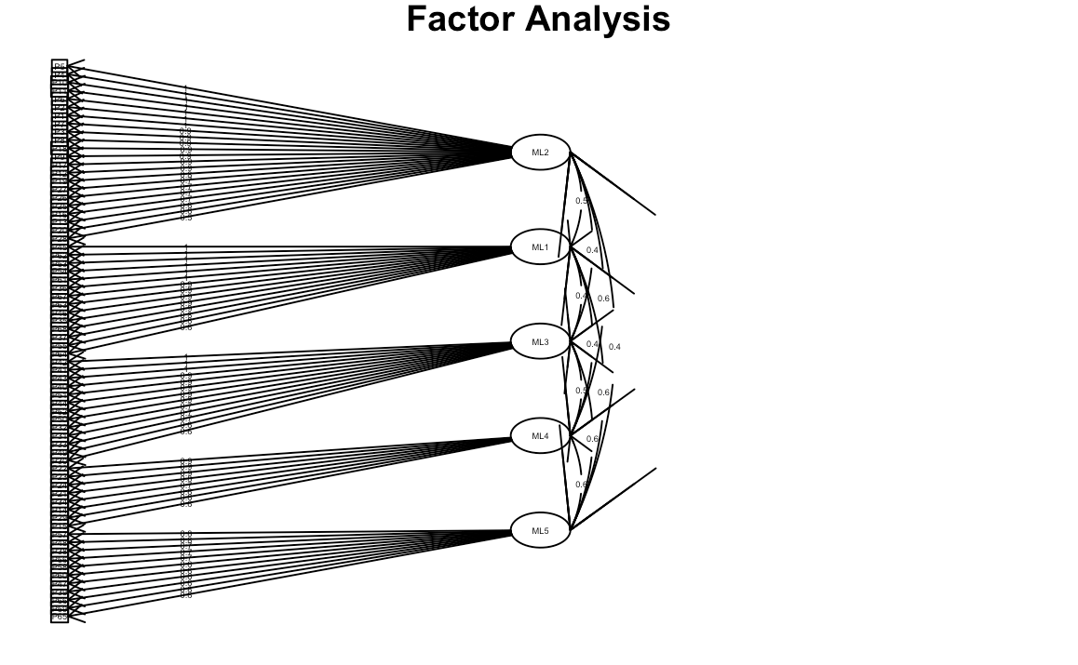
Factor analysis; Clock hour
5 components

Slide 22
broken stick model(区分回帰); dB
Mean RNFL(um)
Wollstein, et al. BJO 2012.
75.3um
Notes:
Figure 1.
Healthy (H) and glaucoma (G) retinal nerve fibre layer (RNFL) thickness in the mean and in
quadrants with corresponding visual field threshold values. Spline fit is the grey line;
‘broken stick’ model is the black line.

Slide 23
1/L (Lambert)
dB = 10*log10(1/L)
1/L = 10^dB/10

Slide 24
broken stick model; 1/Lambert
77.0um
Wollstein, et al. BJO 2012.
Notes:
Figure 2.
Scatter plot of healthy (H) and glaucoma (G) values using unlogged (1/l) visual field
threshold values. The grey line is a spline fit, and the black line is the two-segment ‘broken
stick’ model. RNFL–retinal nerve fiber layer, L–Lambert.

Slide 25
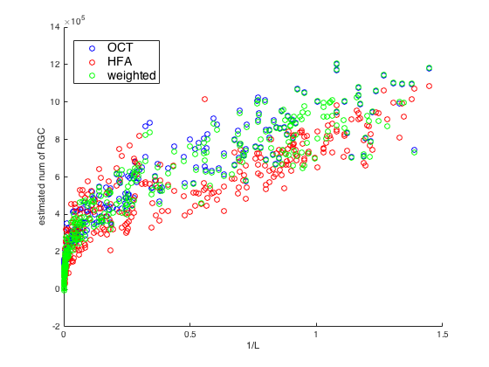
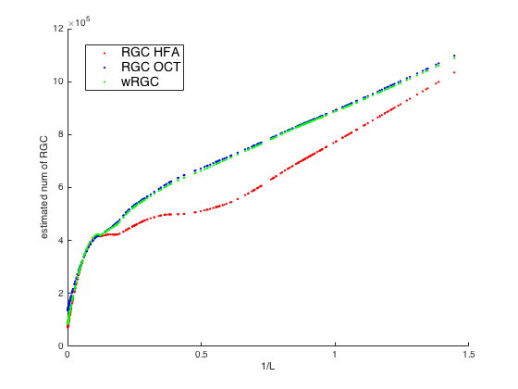
1/L vs RGC from HFA10-2 & OCT (n=336)

Slide 26
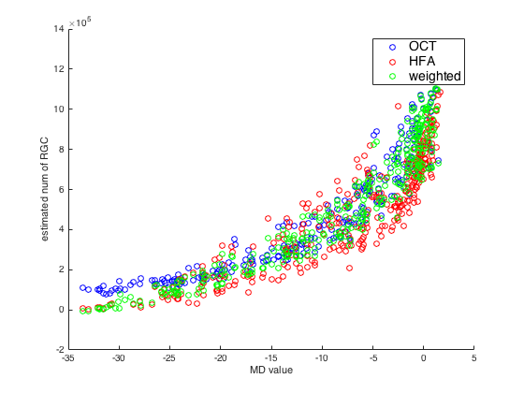
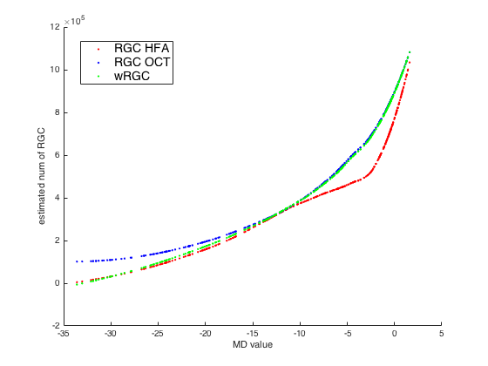
MD vs RGC from HFA10-2 & OCT (n=336)

Slide 27
Bland Altman RGC_HFA10-2, RGC_OCT
Bland Altman法

Slide 28
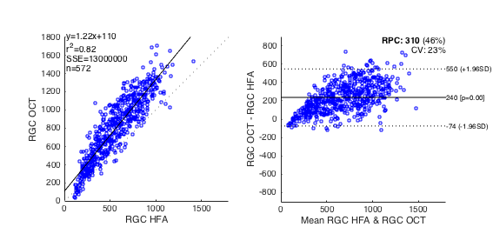
Bland Altman RGC_HFA30-2, RGC_OCT
Bland Altman法
田邉ら 日本視野学会2017
Notes:
HFARGCとOCTRGCの関係をブランドーアルトマン法をもちいて検討しました。
左の図において両者の決定係数は０．８２と強い相関をみとめるものの、右図より有意な比例誤差を認めます(R^2=0.34, P<0.001)。
（測定法により、算出されるRGC数に差があることが証明された）

Slide 29
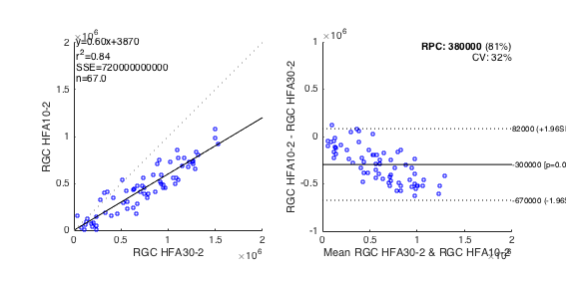
RGC_HFA10-2 vs RGC_HFA30-2 (n = 67)

Slide 30
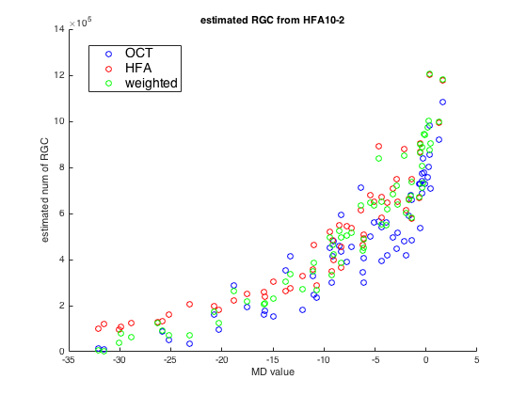
RGC_HFA10-2 vs MD10-2 (n= 67)
RGC_HFA10-2 vs RGC_OCT
R = 0.9175
P = 1.0069e-27

Slide 31
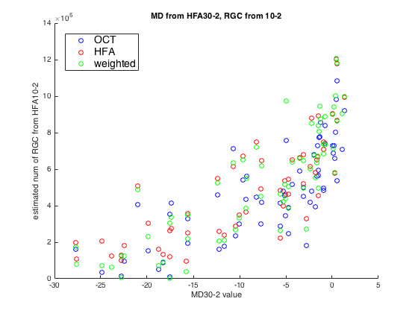
RGC_HFA10-2 vs MD30-2 (n= 67)
RGC_HFA10-2 vs MD30-2
R = 0.787
P = 1.0069e-27

Slide 32
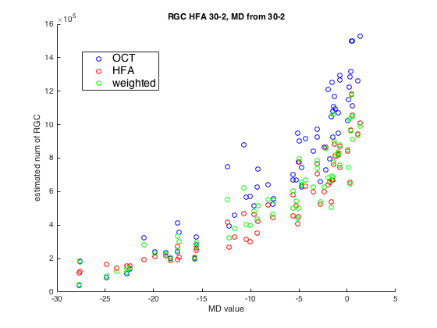
RGC_HFA30-2 vs MD30-2 (n= 67)
R = 0.916

Slide 33
Combined 30-2 with 10-2
 | 27° | 21° | 15° | 9° | 7° | 5° | 3° | 1°
 | 上鼻側 |  |  | 1 |  |  | 2 |  |  | 3 |  |  | 4 |  | 上耳側
21° |  |  | 5 | 6 |  |  | 7 |  |  | 8 |  |  | 9 | 10
15° |  | 11 | 12 | 13 |  |  | 14 |  |  | 15 |  |  | 16 | 17 | 18
9° | 19 | 20 | 21 | 22 |  |  | 23 | 2 | 3 | 24 |  |  | 25 | 26 | 27 | 28
7° |  |  |  |  |  | 5 | 6 | 7 | 8 | 9 | 10
5° |  |  |  |  | 11 | 12 | 13 | 14 | 15 | 16 | 17 | 18
3° | 29 | 30 | 31 | 32 | 20 | 21 | 22 | 23 | 24 | 25 | 26 | 27 | 35 | × | 37 | 38
1° |  |  |  | 29 | 30 | 31 | 32 | 33 | 34 | 35 | 36 | 37 | 38
 |  |  |  | 39 | 40 | 41 | 42 | 43 | 44 | 45 | 46 | 47 | 48
 | 39 | 40 | 41 | 42 | 50 | 51 | 52 | 53 | 54 | 55 | 56 | 57 | 45 | × | 47 | 48
 |  |  |  |  | 59 | 60 | 61 | 62 | 63 | 64 | 65 | 66
 |  |  |  |  |  | 67 | 68 | 69 | 70 | 71 | 72
 | 49 | 50 | 51 | 52 |  |  | 53 | 74 | 75 | 54 |  |  | 55 | 56 | 57 | 58
 |  | 59 | 60 | 61 |  |  | 62 |  |  | 63 |  |  | 64 | 65 | 66
 |  |  | 67 | 68 |  |  | 69 |  |  | 70 |  |  | 71 | 72
 | 下鼻側 |  |  | 73 |  |  | 74 |  |  | 75 |  |  | 76 |  | 下耳側
 |  |  |  |  |  |  |  |  | 右眼

Slide 34
Combined 30-2 with 10-2
 | 27° | 21° | 15° | 9° | 7° | 5° | 3° | 1°
 | 上鼻側 |  |  | 1 |  |  | 2 |  |  | 3 |  |  | 4 |  | 上耳側
21° |  |  | 5 | 6 |  |  | 7 |  |  | 8 |  |  | 9 | 10
15° |  | 11 | 12 | 13 |  |  | 14 |  |  | 15 |  |  | 16 | 17 | 18
9° | 19 | 20 | 21 | 22 |  |  | 23 | 3 | 3 | 24 |  |  | 25 | 26 | 27 | 28
7° |  |  |  |  |  | 3 | 3 | 3 | 3 | 3 | 3
5° |  |  |  |  | 3 | 3 | 3 | 4 | 4 | 4 | 4 | 4
3° | 29 | 30 | 31 | 32 | 3 | 3 | 3 | 4 | 4 | 4 | 4 | 4 | 35 | × | 37 | 38
1° |  |  |  | 3 | 3 | 3 | 1 | 4 | 2 | 2 | 2 | 2 | 2
 |  |  |  | 1 | 1 | 1 | 1 | 1 | 5 | 2 | 2 | 2 | 2
 | 2 | 2 | 2 | 7 | 1 | 1 | 1 | 1 | 5 | 5 | 5 | 5 | 45 | × | 47 | 48
 |  |  |  |  | 1 | 1 | 1 | 1 | 1 | 1 | 1 | 1
 |  |  |  |  |  | 1 | 1 | 1 | 1 | 1 | 1
 | 2 | 2 | 2 | 2 |  |  | 7 | 1 | 1 | 7 |  |  | 7 | 3 | 5 | 5
 |  | 2 | 2 | 2 |  |  | 2 |  |  | 63 |  |  | 64 | 65 | 66
 |  |  | 2 | 2 |  |  | 3 |  |  | 70 |  |  | 71 | 72
 | 下鼻側 |  |  | 3 |  |  | 3 |  |  | 75 |  |  | 76 |  | 下耳側
 |  |  |  |  |  |  |  |  | 右眼
 | 上鼻側 |  |  |  | 3 | 3 |  |  | 上耳側
 |  |  | 3 | 3 | 3 | 3 | 3 | 3
 |  | 3 | 3 | 3 | 4 | 4 | 4 | 4 | 4
 |  | 3 | 3 | 3 | 4 | 4 | 4 | 4 | 4
 | 3 | 3 | 3 | 1 | 4 | 2 | 2 | 2 | 2 | 2 | 10°
 | 1 | 1 | 1 | 1 | 1 | 5 | 2 | 2 | 2 | 2
 |  | 1 | 1 | 1 | 1 | 5 | 5 | 5 | 5
 |  | 1 | 1 | 1 | 1 | 1 | 1 | 1 | 1
 |  |  | 1 | 1 | 1 | 1 | 1 | 1
 | 下鼻側 |  |  |  | 1 | 1 |  |  | 下耳側
 |  |  |  |  | 右眼

Slide 35
 |  |  | 上鼻側 |  |  | 1 | 1 | 1 | 4 |  | 上耳側
 |  |  |  |  | 1 | 1 | 1 | 1 | 1 | 4
 |  |  |  | 1 | 1 | 1 | 1 | 1 | 1 | 4 | 4
 |  |  | 1 | 1 | 1 | 1 | 6 | 6 | 6 | 1 | 4 | 5
 |  |  | 1 | 1 | 1 | 6 | 6 | 6 | 6 | 6 | 5 | 5
 |  |  | 2 | 2 | 2 | 7 | 7 | 7 | 7 |  | 5 | 5
 |  |  | 2 | 2 | 2 | 2 | 7 | 7 | 7 | 3 | 5 | 5
 |  |  |  | 2 | 2 | 2 | 2 | 7 | 3 | 3 | 3
 |  |  |  |  | 2 | 2 | 3 | 3 | 3 | 3
 |  |  | 下鼻側 |  |  | 3 | 3 | 3 | 3 |  | 下耳側
 |  |  |  |  |  |  | 右眼
 | 上鼻側 |  |  | 1 | 2 | 3 | 4 |  | 上耳側
 |  |  | 5 | 6 | 7 | 8 | 9 | 10
 |  | 11 | 12 | 13 | 14 | 15 | 16 | 17 | 18
 | 19 | 20 | 21 | 22 | 23 | 24 | 25 | 26 | 27 | 28
 | 29 | 30 | 31 | 32 | 33 | 34 | 35 | 36 | 37 | 38 | 30°
 | 39 | 40 | 41 | 42 | 43 | 44 | 45 | 46 | 47 | 48
 | 49 | 50 | 51 | 52 | 53 | 54 | 55 | 56 | 57 | 58
 |  | 59 | 60 | 61 | 62 | 63 | 64 | 65 | 66
 |  |  | 67 | 68 | 69 | 70 | 71 | 72
 | 下鼻側 |  |  | 73 | 74 | 75 | 76 |  | 下耳側
 |  |  |  |  | 右眼

Slide 36
10-2 Nakanishi et al. vs Ours
 |  |  |  | 3 | 3
 |  | 3 | 3 | 3 | 3 | 3 | 3
 | 3 | 3 | 3 | 4 | 4 | 4 | 4 | 4
 | 3 | 3 | 3 | 4 | 4 | 4 | 4 | 4
3 | 3 | 3 | 1 | 4 | 2 | 2 | 2 | 2 | 2
1 | 1 | 1 | 1 | 1 | 5 | 2 | 2 | 2 | 2
 | 1 | 1 | 1 | 1 | 5 | 5 | 5 | 5
 | 1 | 1 | 1 | 1 | 1 | 1 | 1 | 1
 |  | 1 | 1 | 1 | 1 | 1 | 1
 |  |  |  | 1 | 1

Slide 37
22 |  |  | 23 | 3 | 3 | 24 |  |  | 25
 |  | 3 | 3 | 3 | 3 | 3 | 3
 | 3 | 3 | 3 | 4 | 4 | 4 | 4 | 4
32 | 3 | 3 | 3 | 4 | 4 | 4 | 4 | 4 | 35
3 | 3 | 3 | 1 | 4 | 2 | 2 | 2 | 2 | 2
1 | 1 | 1 | 1 | 1 | 5 | 2 | 2 | 2 | 2
7 | 1 | 1 | 1 | 1 | 5 | 5 | 5 | 5 | 45
 | 1 | 1 | 1 | 1 | 1 | 1 | 1 | 1
 |  | 1 | 1 | 1 | 1 | 1 | 1
2 |  |  | 7 | 1 | 1 | 7 |  |  | 7

Slide 38
 |  |  |  | 3 | 3
 |  | 3 | 3 | 3 | 3 | 3 | 3
 | 3 | 3 | 3 | 4 | 4 | 4 | 4 | 4
 | 3 | 3 | 3 | 4 | 4 | 4 | 4 | 4
3 | 3 | 3 | 1 | 4 | 2 | 2 | 2 | 2 | 2
1 | 1 | 1 | 1 | 1 | 5 | 2 | 2 | 2 | 2
 | 1 | 1 | 1 | 1 | 5 | 5 | 5 | 5
 | 1 | 1 | 1 | 1 | 1 | 1 | 1 | 1
 |  | 1 | 1 | 1 | 1 | 1 | 1
 |  |  |  | 1 | 1

Slide 40
POAG N = 853
Parallel analysis suggests that the number of factors = 5 and the number of components = 3

Slide 41
POAG N = 853
Cumulative Var = 0.73

Slide 42
3
3
4
4

Slide 43
 |  |  |  | 3 | 3
 |  | 3 | 3 | 3 | 3 | 3 | 3
 | 3 | 3 | 3 | 4 | 4 | 4 | 4 | 4
 | 3 | 3 | 3 | 4 | 4 | 4 | 4 | 4
3 | 3 | 3 | 1 | 4 | 2 | 2 | 2 | 2 | 2
1 | 1 | 1 | 1 | 1 | 5 | 2 | 2 | 2 | 2
 | 1 | 1 | 1 | 1 | 5 | 5 | 5 | 5
 | 1 | 1 | 1 | 1 | 1 | 1 | 1 | 1
 |  | 1 | 1 | 1 | 1 | 1 | 1
 |  |  |  | 1 | 1

Slide 46
A model is a model
Raza SA, Hood CD. IOVS 2015

Slide 47
30-2 測定点配置
 | 上耳側 |  |  | 4 | 3 | 2 | 1 |  | 上鼻側 |  |  |  |  | 上鼻側 |  |  | 1 | 2 | 3 | 4 |  | 上耳側
 |  |  | 10 | 9 | 8 | 7 | 6 | 5 |  |  |  |  |  |  |  | 5 | 6 | 7 | 8 | 9 | 10
 |  | 18 | 17 | 16 | 15 | 14 | 13 | 12 | 11 |  |  |  |  |  | 11 | 12 | 13 | 14 | 15 | 16 | 17 | 18
 | 28 | 27 | 26 | 25 | 24 | 23 | 22 | 21 | 20 | 19 |  |  |  | 19 | 20 | 21 | 22 | 23 | 24 | 25 | 26 | 27 | 28
30° | 38 | 37 | 36 | 35 | 34 | 33 | 32 | 31 | 30 | 29 |  |  |  | 29 | 30 | 31 | 32 | 33 | 34 | 35 | 36 | 37 | 38 | 30°
 | 48 | 47 | 46 | 45 | 44 | 43 | 42 | 41 | 40 | 39 |  |  |  | 39 | 40 | 41 | 42 | 43 | 44 | 45 | 46 | 47 | 48
 | 58 | 67 | 56 | 55 | 54 | 53 | 52 | 51 | 50 | 49 |  |  |  | 49 | 50 | 51 | 52 | 53 | 54 | 55 | 56 | 57 | 58
 |  | 66 | 65 | 64 | 63 | 62 | 61 | 60 | 59 |  |  |  |  |  | 59 | 60 | 61 | 62 | 63 | 64 | 65 | 66
 |  |  | 72 | 71 | 70 | 69 | 68 | 67 |  |  |  |  |  |  |  | 67 | 68 | 69 | 70 | 71 | 72
 | 下耳側 |  |  | 76 | 75 | 74 | 73 |  | 下鼻側 |  |  |  |  | 下鼻側 |  |  | 73 | 74 | 75 | 76 |  | 下耳側
 |  |  |  |  | 左眼 |  |  |  |  |  |  |  |  |  |  |  |  | 右眼

Slide 48
10-2 測定点配置
 | 上耳側 |  |  |  | 3 | 2 |  |  | 上鼻側 |  |  |  |  | 上鼻側 |  |  |  | 2 | 3 |  |  | 上耳側
 |  |  | 10 | 9 | 8 | 7 | 6 | 5 |  |  |  |  |  |  |  | 5 | 6 | 7 | 8 | 9 | 10
 |  | 18 | 17 | 16 | 15 | 14 | 13 | 12 | 11 |  |  |  |  |  | 11 | 12 | 13 | 14 | 15 | 16 | 17 | 18
 |  | 27 | 26 | 25 | 24 | 23 | 22 | 21 | 20 |  |  |  |  |  | 20 | 21 | 22 | 23 | 24 | 25 | 26 | 27
10° | 38 | 37 | 36 | 35 | 34 | 33 | 32 | 31 | 30 | 29 |  |  |  | 29 | 30 | 31 | 32 | 33 | 34 | 35 | 36 | 37 | 38 | 10°
 | 48 | 47 | 46 | 45 | 44 | 43 | 42 | 41 | 40 | 39 |  |  |  | 39 | 40 | 41 | 42 | 43 | 44 | 45 | 46 | 47 | 48
 |  | 67 | 56 | 55 | 54 | 53 | 52 | 51 | 50 |  |  |  |  |  | 50 | 51 | 52 | 53 | 54 | 55 | 56 | 57
 |  | 66 | 65 | 64 | 63 | 62 | 61 | 60 | 59 |  |  |  |  |  | 59 | 60 | 61 | 62 | 63 | 64 | 65 | 66
 |  |  | 72 | 71 | 70 | 69 | 68 | 67 |  |  |  |  |  |  |  | 67 | 68 | 69 | 70 | 71 | 72
 | 下耳側 |  |  |  | 75 | 74 |  |  | 下鼻側 |  |  |  |  | 下鼻側 |  |  |  | 74 | 75 |  |  | 下耳側
 |  |  |  |  | 左眼 |  |  |  |  |  |  |  |  |  |  |  |  | 右眼

Slide 49
30-2 測定点配置
 | 上鼻側 |  |  | 1 | 2 | 3 | 4 |  | 上耳側
 |  |  | 5 | 6 | 7 | 8 | 9 | 10
 |  | 11 | 12 | 13 | 14 | 15 | 16 | 17 | 18
 | 19 | 20 | 21 | 22 | 23 | 24 | 25 | 26 | 27 | 28
 | 29 | 30 | 31 | 32 | 33 | 34 | 35 | 36 | 37 | 38 | 30°
 | 39 | 40 | 41 | 42 | 43 | 44 | 45 | 46 | 47 | 48
 | 49 | 50 | 51 | 52 | 53 | 54 | 55 | 56 | 57 | 58
 |  | 59 | 60 | 61 | 62 | 63 | 64 | 65 | 66
 |  |  | 67 | 68 | 69 | 70 | 71 | 72
 | 下鼻側 |  |  | 73 | 74 | 75 | 76 |  | 下耳側
 |  |  |  |  | 右眼

Slide 50
10-2 測定点配置
 | 上鼻側 |  |  |  | 2 | 3 |  |  | 上耳側
 |  |  | 5 | 6 | 7 | 8 | 9 | 10
 |  | 11 | 12 | 13 | 14 | 15 | 16 | 17 | 18
 |  | 20 | 21 | 22 | 23 | 24 | 25 | 26 | 27
 | 29 | 30 | 31 | 32 | 33 | 34 | 35 | 36 | 37 | 38 | 10°
 | 39 | 40 | 41 | 42 | 43 | 44 | 45 | 46 | 47 | 48
 |  | 50 | 51 | 52 | 53 | 54 | 55 | 56 | 57
 |  | 59 | 60 | 61 | 62 | 63 | 64 | 65 | 66
 |  |  | 67 | 68 | 69 | 70 | 71 | 72
 | 下鼻側 |  |  |  | 74 | 75 |  |  | 下耳側
 |  |  |  |  | 右眼

